Slide 1
R Package invitroTKstats
R package for informatic and statistical analysis of in vitro toxicokinetic data
Assays covered:
f_{up} -- fraction unbound in plasma measured by ultracentrifugation (UC) and rapid equilibrium dialysis (RED)
Cl_{int} -- Hepatic clearance
Membrane permeability rates from Caco2
R_{b:p} -- blood:plasma chemical concentration ratio
Benefits:
Data stored in text files that can be tracked using version control software and are database-ready
Analysis can be scripted
Both frequentist (point) and Bayesian estimation methods available
Helper functions can summarize information such as chemical analysis methods across assays
Documentation:
QAPP and SOP in preparation
Github repository can be made public with release of first data paper
Journal of Statistical Software manuscript planned

Slide 2
invitroTKstats Data Hierarchy
Level 0
Data as prepared by lab (EPA or contractor) preserved for auditing purposes (for example, Microsoft Excel)
Level 1
Data with one row per measurement in text format (for tracking with version control software) and fully annotated for loading in database
Level 2
Data with each measurement annotated as to whether it should be included in subsequent analysis
Level 3
Level 4
Per chemical calculation of TK parameter (point estimate)
Per chemical calculation of TK parameter (Bayesian) with 95% credible interval

Slide 3
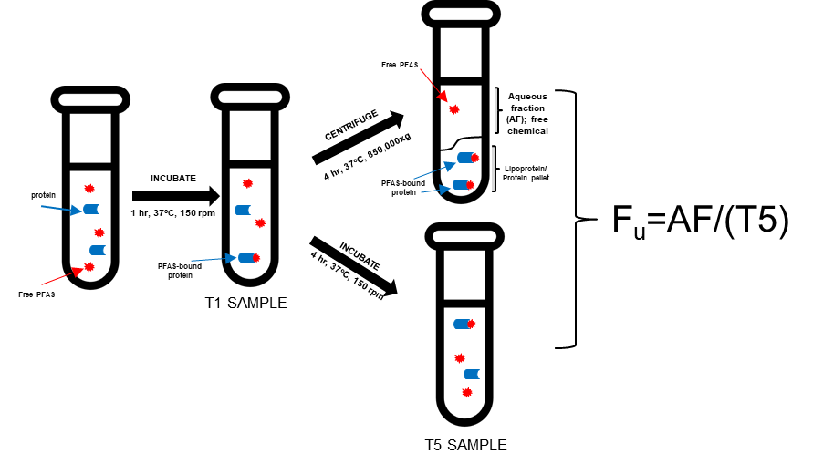
Calculation of f_{up} from Ultracentrifugation (UC) Data
Observation types: aqueous fraction (AF), time 1 hour (T1), time 5 hours (T5), calibration curve (CC), and blanks (BLANK)
Currently T1 ignored, blanks treated as CC for concentration 0
Point estimation function does not use CC
Functions
format_fup_uc -- creates level 1 file
calc_fup_uc_point – calculates point estimate of fup from level 2 file
calc_fup_uc – calculates Bayesian estimate of fup from level 2 file

Slide 4
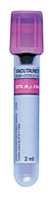
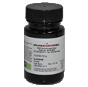
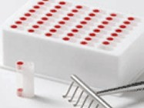
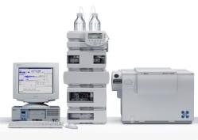
Calculation of f_{up} from Rapid Equilibrium Dialysis (RED) Data
Observation types: aqueous fraction (AF), time 1 hour (T1), time 5 hours (T5), calibration curve (CC), and blanks (BLANK)
Currently T1 ignored, blanks treated as CC for concentration 0
Point estimation function does not use CC
.
.
.
1
2
.
.
.
.
.
.
.
.
Double-wells connected by semi-permeable membrane on a Rapid Equilibrium Dialysis (RED) Plate
Add plasma (6 donor pool for human) to one well
Add chemical
Incubate plates to allow wells with and without protein to come to equilibrium
Determine concentration in both wells (analytical chemistry)
Functions
format_fup_red-- creates level 1 file
calc_fup_red_point – calculates point estimate of fup from level 2 file
calc_fup_red_base – calculates Bayesian estimate of fup from level 2 file using only 100% physiogic plasma protein data
calc_fup_red_affinity – calculates Bayesian estimate using plasma protein titration data
Rapid Equilibrium Dialysis (RED) Waters et al. (2008)

Slide 5

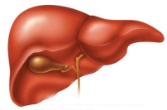
Calculation of Cl_{int} Hepatocyte Incubation Data
Observation types: aqueous fraction (AF), time 1 hour (T1), time 5 hours (T5), calibration curve (CC), and blanks (BLANK)
Currently T1 ignored, blanks treated as CC for concentration 0
Point estimation function does not use CC
Cryopreserved hepatocyte suspension
Shibata et al. (2002)
Cryopreserved
Hepatocytes
(10 donor pool for human)
Add Chemical
(1 and 10 µM)
Remove Aliquots at 15, 30, 60, 120 min
Analytical Chemistry
The rate of disappearance of parent compound (slope of line) is the hepatic clearance
(µL/min/10⁶ hepatocytes)
Log Conc (µM)
10 µM
Functions
format_fup_uc -- creates level 1 file
calc_clint_point – calculates point estimate of Cl_{int} from level 2 file
calc_ clint– calculates Bayesian estimate of Cl_{int} from level 2 file
1 µM
We perform the assay at 1 and 10 µM to check for saturation of metabolizing enzymes.
0
50
100
150

Slide 6


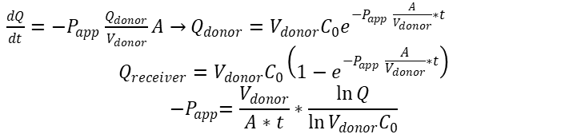
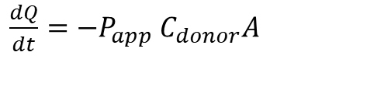

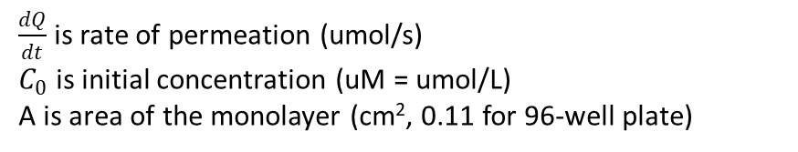
Calculation of Membrane Permeability from Caco-2 Data
Observation types: donor concentration (time 0) (D0), donor (time 2 h) (D2), receiver concentration (time 2 h) (R2), and blanks (BLANK)
Membrane permeability (coefficient P_{app}, cm/s) for change in mass Q (µmol) as a function of concentration and membrane area
$\frac{dQ}{dt}={−P}_{app}$ $C_{donor}A$
$\frac{dQ}{dt}$ is rate of permeation (umol/s)
$C_{0}$ is initial concentration (uM = umol/L)
A is area of the monolayer (cm², 0.11 for 96-well plate)
Apical (vol 0.075 cm³)
For A->B permeability dosing solution is added here
Basal (vol 0.25 cm³)
Caco-2 Monolayer
Apparent permeability coefficients (Papp) and Efflux Ratio ($R_{efflux}$):
$$P_{app}=\frac{\frac{dQ}{dt}}{C_{0}A}$$
$$R_{efflux}=\frac{P_{app}^{B2A}}{P_{app}^{A2B}}$$
Add dosing solution here for B->A permeability
$$\frac{dQ}{dt}≈\frac{∆Q}{∆t}=\frac{C_{receiver}V_{receiver}}{∆t}$$
C₀ is determined from the peak area ratio of the dosing solution
Functions
format_caco2-- creates level 1 file
calc_caco2_point – calculates point estimate of P_{app}^{A2B}, P_{app}^{B2A}, and Efflux Ratio from level 2 file
calc_caco2– calculates Bayesian estimate of P_{app}^{A2B}, P_{app}^{B2A}, and Efflux Ratio from level 2 file
Note that we could be more precise (use this for Bayesian calculation)
$\frac{dQ}{dt}={−P}_{app}$ $\frac{Q_{donor}}{V_{donor}}A→$ $Q_{donor}={V_{donor}C_{0}e}^{{−P}_{app} \frac{A}{V_{donor}}∗t}$
$$Q_{receiver}=V_{donor}C_{0}\left(1−e^{{−P}_{app} \frac{A}{V_{donor}}∗t}\right)$$
$${−P}_{app}=\frac{V_{donor}}{A∗t}∗\frac{\ln{Q}}{\ln{V_{donor}C_{0}}}$$

Slide 7
Calculation of R_{blood:plasmat} From In Vitro Data
Observation types: aqueous fraction (AF), time 1 hour (T1), time 5 hours (T5), calibration curve (CC), and blanks (BLANK)
Currently T1 ignored, blanks treated as CC for concentration 0
Point estimation function does not use CC
Functions
format_rb2p -- creates level 1 file
calc_ b2p _point – calculates point estimate of Rb:p from level 2 file
calc_rb2p– calculates Bayesian estimate of Rb:p from level 2 file

Slide 8
Accessory Functions
Functions
create_chem_table -- Creates a standardized data table of chemical identities from a level 1 or level 2 file
create_method_table -- Creates a standardized data table for chemical analysis methodsfrom a level 1 or level 2 file

Slide 9
Bayesian Framework
Two Models:
First model is for analytical chemistry – uses information on blanks, any calibration curve, and variability of observations to estimate the relationship between chemical concentration and mass spectrometry peak area
Heteroskedastic – both a constant error term and an error term that is proportional to signal
Separate sets of calibration parameters estimated for measurements occuring on different days
Second model is for the in vitro toxicokinetic parameter measurement process
All observations used contribute to an estimate of a distribution of plausible parameter values for both models.
The range of these distributions reflect the estimated uncertainty
We use Markov Chain Monte Carlo (MCMC) to estimate the sets of plausible parameters – this introduces an element of randomness but we use random number generator seeds to create reproducible pseudorandom sequences
The Bayesian estimates can take several minutes to perform and are prone to crashing because of unfortunate parameter combinations – for this reason the functions for Bayesian analysis can be restarted at the chemical where they crashed
Delete the Level4 file if this behavior is not desired
The MCMC process uses multiple “chains” which can be run in parallel if multiple computer cores are available

